Slide 1
ITMS528 Database Security
Jimit Shah
Database in Cloud
Security risks and commonly accepted practices
School of Applied Technology
Information Technology and Management
Illinois Intstitute of Technology, Chicago.

Slide 2
Introduction
goal:
get context, overview, “feel” of cloud database
understand cloud computing service models
approach:
Database as a Service (DBaaS)
Advantages and Disadvantages
Security challanges and practices
Overview:
what is the cloud database
structure of cloud database
cloud computing service models
what’s a DBaaS and basic capabilities
security trade-offs between service models
deployment of database in cloud
advantages of cloud database
security challenges and practices
encryption methods and best practice to secure data in cloud.
comparison chart (providers)

Slide 3
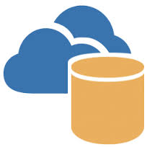




What’s the Cloud Database?
PC
a database can be accessed via the internet (not a local database)
Available for users on demand.
is mostly used as a service that which also referred by Database as a Service.
Implemented using cloud computing and can be provided by some service provider.
offers many benefits such as:
automated and rapid resource provisioning
flexibility
high availability, and
faster time to market at a reduced total cost of ownership.
server
wireless
laptop
cellular
handheld
Notes:
3

Slide 4
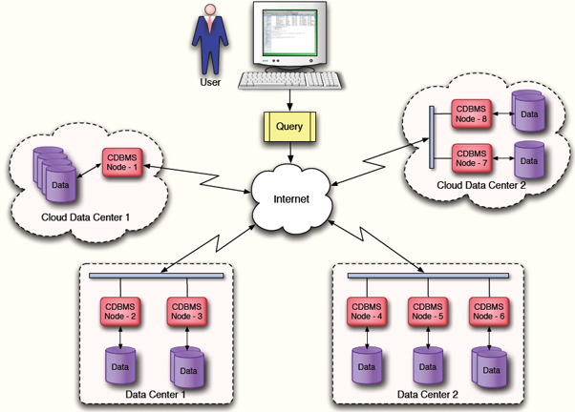
Structure of cloud database: “nuts and bolts” view
The architecture holds the data on multiple data centers that are normally located at different geographical location
more protection against catastrophic events
self-service restore gives customer more control over data restoration.
A cloud database management system (CDBMS) that provides query services.
Interconnected database network enables on-demand and anywhere access via internet.
Allows connectivity to devices:
hosts, end-systems
PCs, workstations, servers
PDAs, laptops, tablets, smartphones
using wired or wireless networks.
Communication links
fiber, copper, radio, satellite
point-to-point (p2p) links within organizations
peer-to-peer connections across geo locations.
PC
server
wireless
laptop
cellular
handheld
Notes:
4
The architecture holds the data on multiple data centers that are normally located at different geographical location
- provides more protection against catastrophic events
- self-service restore that gives customer more control over data restoration from available data backups.
Also refered as cloud database management system (CDBMS) that provides query services.
Interconnected database netowork enables on-demand and anywhere access via internet.
Allows connectivity to computing devices: hosts, end-systems
PCs, workstations, servers
PDAs, laptops, tablets, smartphones
using wired or wireless networks.
Communication links
fiber, copper, radio, satellite
point-to-point (p2p) links within organizations
peer-to-peer connections across geo locations.

Slide 5
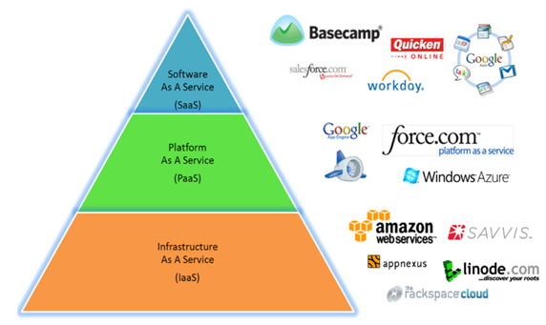
Cloud computing service models
The National Institute of Standards and Technology (NIST)
divided into three main service models
known as the SPI model (Software, Platform and Infrastructure).
The SPI model for cloud computing helps a user to understand what should expect from the cloud computing technology.
Notes:
5

Slide 6
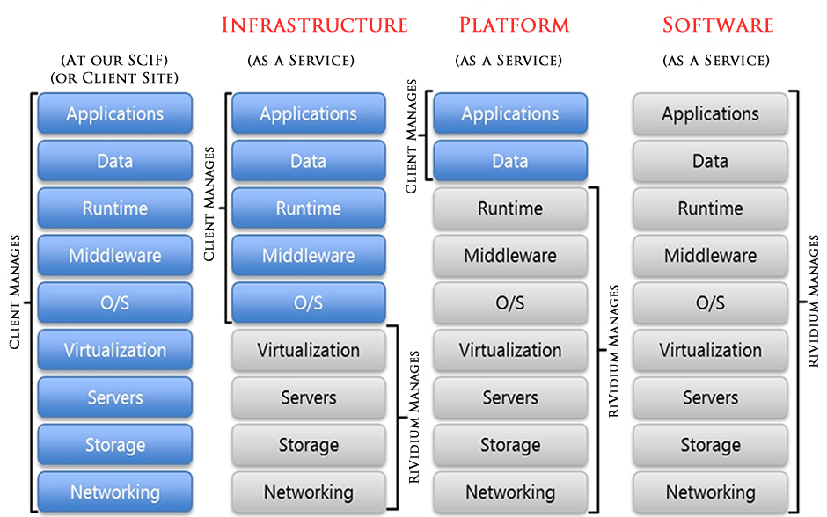
Cloud computing service models: IaaS
Infrastructure as a Service (IaaS)
The model provides consumers the ability to rent physical facilities, hardware and connectivity
Consumers deploy their own software, operating systems or other applications.
It is also sometimes referred as hardware-as-a- Service.
IaaS provides many on-demand virtualized resources to consumers such as
computation, storage, communication, etc.
The service providers manage their equipment and also responsible for all maintenance for their consumer.
the consumers are normally charged as usage basis.
Some major IaaS vendors are: Amazon EC2, RackSpace and IBM.
Notes:
6

Slide 7
Cloud computing service models: PaaS
Platform as a Service (PaaS)
built on top of IaaS
provide functionalities: application development frameworks, middleware capabilities and database functions.
offers platform for dedicated server such as database servers and web servers.
monitoring and building such a platform is not only time consuming and vigorous task but also requires on going maintenance and additional resources.
that is why, PaaS offers the platform to consumers through a web browser by enabling to host all development tools in the cloud.
allowing consumers to focus only on their software development without worrying about management of the underlying infrastructure.
some of the leading PaaS vendors are: Amazon AWS, RedHat OpenShift, Windows Azure Cloud Services, Google Apps Engine.
Notes:
7

Slide 8
Cloud computing service models: SaaS
Software as a Service (SaaS)
build upon both IaaS and PaaS stacks
enables the consumers to host their applications on provider’s cloud infrastructure
The Software (application) can be accessed by either using any client devices such as graphical user interface (GUI) provided by the SaaS provider or via a web browser.
allows consumers to rent software applications that are delivered on a pay-per-use basis
SaaS providers: Google Apps, Salesforce CRM, Oracle CRM on demand.
Notes:
8

Slide 9
What’s the Database as a Service (DBaaS)?
DBaaS is another emerging cloud services that also falls into SPI models.
Subtype of SaaS and PaaS depending on services provided.
As described in an oracle white paper,
“Database as a Service (DBaaS) is an architectural and operational approach enabling IT providers to deliver database functionality as a service to one or more consumers. ”
DBaaS architecture supports the following necessary capabilities:
Consumer-based provisioning and management of database instance using on-demand, self-service mechanism.
Automated monitoring of database and compliance with provider-defined service definitions, attributes and quality of service levels.
Metering of database usage for various reporting needs for each individual consumer.
Also support all traditional database architecture attributes
granular service elasticity, scalability, automated resource management, and integrated capacity planning.
Notes:
9

Slide 10
Security trade-offs between service models
All Service Models provide different features and security requirements.
SaaS
High level of Security
Built in functionality
Least amount of extensibility to its consumers
PaaS
Great amount of extensibility to developers
Some integrated security
Some built in functionality.
Consumers have option to add on additional security as needed.
IaaS
Most extensibility to consumers
Least integrated security features.
Almost none built-in functionalities.
Provider mostly responsible to protects only infrastructure itself.
OS, applications and content of the servers usually requires to managed and secured by the cloud consumer.
Shown the comparison in next slide.
Notes:
10
The architecture holds the data on multiple data centers that are normally located at different geographical location
- provides more protection against catastrophic events
- self-service restore that gives customer more control over data restoration from available data backups.
Also refered as cloud database management system (CDBMS) that provides query services.
Interconnected database netowork enables on-demand and anywhere access via internet.
Allows connectivity to computing devices: hosts, end-systems
PCs, workstations, servers
PDAs, laptops, tablets, smartphones
using wired or wireless networks.
Communication links
fiber, copper, radio, satellite
point-to-point (p2p) links within organizations
peer-to-peer connections across geo locations.

Slide 11
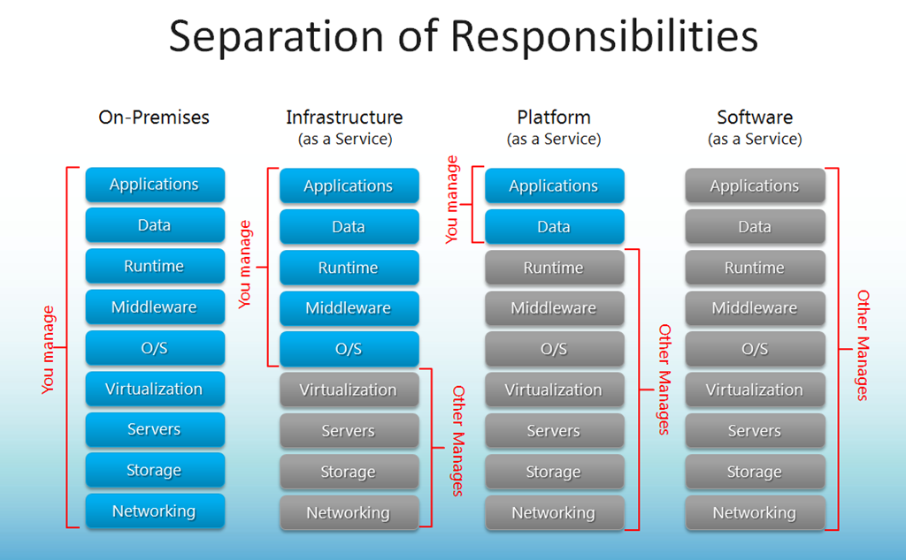
Security trade-offs between service models
Notes:
11
The architecture holds the data on multiple data centers that are normally located at different geographical location
- provides more protection against catastrophic events
- self-service restore that gives customer more control over data restoration from available data backups.
Also refered as cloud database management system (CDBMS) that provides query services.
Interconnected database netowork enables on-demand and anywhere access via internet.
Allows connectivity to computing devices: hosts, end-systems
PCs, workstations, servers
PDAs, laptops, tablets, smartphones
using wired or wireless networks.
Communication links
fiber, copper, radio, satellite
point-to-point (p2p) links within organizations
peer-to-peer connections across geo locations.

Slide 12
Deploying database in cloud environment
Two main approach:
Do-it-yourself:
consumer can purchase IaaS service from a cloud service provider and then install database server on the platform.
consumer is responsible for maintenance, management and updating versions of the database instances
consumer can install any additional monitoring and auditing tools on the platform to serve their custom needs.
Subscribe to full-featured Database-as-a-Service (DBaaS):
Offers on-demand database services, ready to use.
all the management, maintenance, and update responsibilities will be of provider
billed only pay per use basis
consumers do not have control over installing any additional tools on their database platforms
mostly forced to use provider’s monitoring and security tools.
Notes:
12

Slide 13
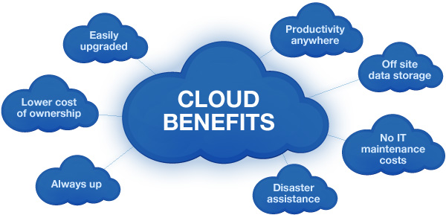
Advantages of deploying database in cloud
Main advantages:
Affordability
Reduce operational and maintenance costs
Pay per use only
Flexibility and scalability
We live in digital time and so need more storage
Easy to scale up or down as needs changes
Increased Efficiency
Accessible and available anywhere and anytime
DBAs can manage database virtually from anywhere around the world
Disaster assistant and platform independent

Slide 14
Security challanges of database in cloud
Some security concerns that any organization should take into consideration:
Availability
Business Continuity Perspective
Protection against disasters, hardware failure, Denial of Service (DOS) attacks, etc.
Temporary or long term outages (expected interruption of service)
I.e. Amazon EC2 and S3 suffered three hour of outage
Loss of Access control
Major threat related to public cloud
No physical, logical and personnel control over provider’s environment
Exposed to provider’s internal and external threats
Use of proper encryption, auditing and monitoring database services can minimize this challenge.
Auditing and monitoring issues
To support benefits of elasticity and flexibility, host servers often get provisioned and de-provisioned automatically.
Consumers data is usually spread across multiple geo-locations to support high availability and redundancy which makes the underlying infrastructure invisible.
Dynamic or non-static nature of cloud can cause constant configuration changes and may require installations of authenticating tools for users.
A distributed cloud approach can help over come these challenges.

Slide 15
Security challanges of database in cloud
Data Sanitization
Involves the deleting of data from storage media by overwriting, de-magnetizing or destroying media itself to prevent unauthorized disclosure of information.
data from different customers may physically co-located together
If not erased or destroyed properly, it is possible that someone can recover confidential data
Service Level Agreements (SLAs) should specify all the measures and procedures in place
Data Privacy
The privacy is the most important concern of having database in cloud.
Cloud database services are more advanced to manage users accessibility in secured ways
It also protects from outside threats and attacks.
Any organization can not afford to leak out their information stored in cloud.
Encryption is the solution to store data in most secured way.
Data needs to be secured during both “in transit” and “at rest”.
Encryption keys and certificates should be managed by consumers to ensure privacy.

Slide 16
Encryption methods and practices
Encryption for data
“In Transit” – offered by most providers (using TLS/SSL), HTTPS, and some offers virtual private cloud (VPC) services.
“at rest” – using Transparent Data Encryption (TDE), data stored at rest in the underlying storage is encrypted, as are its automated backups, read replicas, and snapshots. Consumer can also encrypt data at application level before sending to the database.
Cryptography
Method to encrypt and decrypt data using a private and/or public key
Keys are generated using cipher text
Cryptosystem is the most common secret key used, it uses Data Encryption Stadards (DES)
Triple-DES which encrypts data three times (more stronger)
Digital Signatures and Certificates
Electronic signatures can be use to define electronic process, application captures unique information of the user and generate signatures.
Digital Certificate is an attachment applied to a program, database or electronic content.
Commercial Certificates: attained through a commercial certification authority such as Verisign
Internal digital certificates: are deliberately for use on single system or within a single organization and normally produced using the Selfcert.exe type program by Internal administrator.
SSL certificates are most common, issued by Certificate Authorities (CAs).

Slide 17
Comparisons of some major providers
 | Amazon RDS(MySQL) | Microsoft SQL Azure | Google Datastore | Amazon SimpleDB
Type | RDBMS | RDBMS | NoSQL | NoSQL
Maximum amount of data that can be stored | 1 terabyte per database | 50 gigabytes per database | Not published for entire database but 1 MB limit on a subset of data (called an entity). Limit to the number of indexes. | 10 gigabytes per database domain (roughly equivalent to an RDBMS table)
Ease of software Portability with similar, locally hosted capability | High. MySQL instantiation in cloud is very similar to the local instantiated version. | High. Most SQL Server features are available in SQL Azure. | Medium/Low. Requires Java Data Objects or datastore-specific interface and use of App Engine. | Medium. Requires SimpleDB-specific interface.
Transaction capabilities | Yes | Yes | Yes | Yes
Configurability and ability to tune database | High. MySQL instantiation in cloud. | Medium. Can create indexes and stored procedures but no control over memory allocation or similar resources. | Low | Low
Database accessible as “stand-alone” offerings | Yes | Yes | No. Requires Google App Engine application layer. | Yes
Federal Information Security Management Act (FISMA) Certified | Yes (underlying cloud infrastructure of AWS) | Yes (cloud infrastructure) | Yes (for the google app engine and cloud platform) | Yes
Can designate where data is stored (i.e. region or data center) | Yes | Yes | No | Yes
Replication | Yes | Yes | Yes | Yes

Slide 18
Conclusion
We reviewed the concept of cloud computing models and database.
We also reviewed main risk factors and challenges assoicated with database security in cloud.
Affordability, flexibility and scalability are the major benefits of having database in cloud.
Earlier the organizations set up their own data center and have their traditional database. Now the cloud database has evolved to a new dimension Database as a Service (DBaaS).
This allows the companies and organizations to use the resources of the DBaaS providers and without any hassle to invest and maintain the hardware and software or the infrastructure for their data centers.
There are advantages and disadvantages as we reviewed; however, the adoption of the cloud database has proven that the advantages are more than the disadvantages.
The cloud database services have offered many benefits and many service providers are in the race. Therefore, an organization should choose the one that best suits its requirements.

Slide 19
References
“Top Benefits of Database Cloud Computing” http://blog.caspio.com/paas-in-action/top-benefits-of-database-cloud- computing/
Database security in a cloud computing environment, IT world, http://www.itworld.com/article/2764788/security/database-security-in-a-cloud-computing-environment.html
What is an SSL certificate, https://www.instantssl.com/ssl-certificate.html
“CLOUD DATABASE - DATABASE AS A SERVICE”, http://airccse.org/journal/ijdms/papers/5213ijdms01
Judith Hurwitz, Robin Bloor, Marcia Kaufman, and Dr. Fern Halper, Cloud Computing for Dummies, Wiley Publishing, Inc. USA, 2010, ISBN: 978-0-470-48470-8.
“Database as a Service: Reference Architecture – An Overview”, An Oracle White Paper on Enterprise Architecture September 2011.
EMC Education Services (2012-04-30). Information Storage and Management: Storing, Managing, and Protecting Digital Information in Classic, Virtualized, and Cloud Environments (Kindle Locations 5603-5607). Wiley. Kindle Edition.
NIST, Guidelines on Security and Privacy in Public Cloud Computing, December 2011, http://csrc.nist.gov/publications/nistpubs/800-145/SP800-145.pdf
Overnight AWS Outage Reminds World How Important AWS Stability Really Is, http://www.crn.com/news/cloud/300077740/overnight-aws-outage-reminds- world-how-important-aws-stability-really-is.htm
Search unified communications, http://searchunifiedcommunications.techtarget.com/tip/The-truth-about-five-nines-availability-in-unified-communications-networks, 2012-05-30
Introduction to Privacy and Data Security FAQ, https://aws.amazon.com/compliance/data-privacy-faq/

Slide 20

Questions?

